Slide 1
Linguistics 200, Day 1
So You've Decided to Create Your Own Language...

Slide 2

Welcome!

Slide 3

My Linguistics Background
Trained in historical linguistics
Indo-European languages
Sounds
Current research focuses:
DERBi PIE
Phylogenetics
Public materials for learning about PIE

Slide 4

Why I teach / do conlangs...
Recordings of PIE went viral
Together with my wife (Brenna Byrd, German prof. @ UK), hired to make historical constructed languages (conlangs):
History Channel (Vikings)
National Geographic (Origins)
Ubisoft (Far Cry Primal)
Most recent conlang that I can talk about: Th'anthk (Flintlock: Siege of Dawn – though much of it replaced last minute with lines in English :( )

Slide 5
About LIN 200…
Designed to be fully online
What that means for you:
Much of the conceptual learning will be at home
In class we do the creating!

Slide 6
What this really means!
Most of your language will be constructed IN CLASS
This will give you the most / best feedback for you from your groupmates and me
Coming to class is very important!

Slide 7
How you will learn about how languages work
In a variety of ways:
Class Videos
The Art of Language Invention (+ questions)
In-class activities

Slide 8

As professional conlangers, we have to make pitches based off of material that's been given to us

Slide 9
In Primal:
Names we were given:
Tensay
Takkar
Wenja
Izila
Udam
Urki

Slide 10
In Flintlock:
God names we were given:
Enki

Slide 11

In this class:

Slide 12
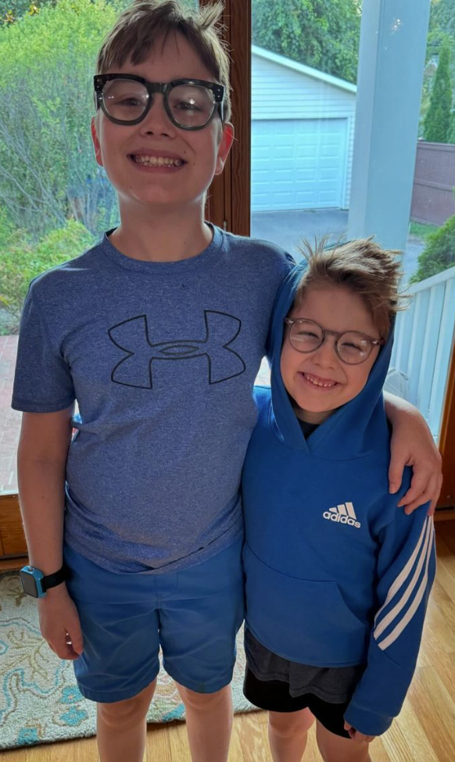
Designing Dorgon
After the first component, you'll be working together in your groups to pitch ideas of linguistic features to my seven year old, Elijah

Slide 13
Designing Dorgon
Sound System & Lexicon (week 7)
How Nouns Work (week 8)
How Verbs Work (week 9)
Writing System (week 13)

Slide 14
All of this is preparation for: creating your own language
Most important part of the course!
You'll be doing this in four components, capped off with a final creative work, such as a story, poem, performance, etc.

Slide 15
Let’s check out the Canvas course shell
Syllabus
Home Page
Modules: how-to, videos, check-in quizzes, project components

Slide 16
Office Hours: MWF 9:15/30-9:50

Slide 17
Prior linguistic experience & grading
How will your languages be graded?

Slide 18
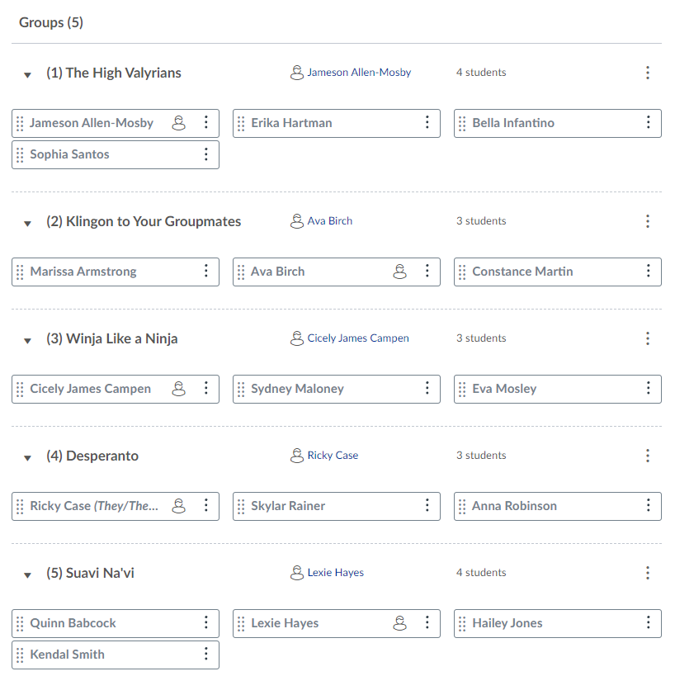
Groups

Slide 19
Final Note
Arts & Creativity ≠ Unimportant !!!

Slide 20
For the rest of today
E-mail Dr. Byrd with your UK e-mail address
Join the LIN 200 Discord server
Get to know your neighbors! Each of you will answer the following questions, giving answers which another group member will type up in Discord.
1) Introduce yourselves. What is your name? Where are you from? What is your major? Why are you taking LIN 200?
2) Discuss any background you might have with languages, linguistics, and conlangs.
3) Tell your group members your favorite sci-fi or fantasy movie, TV show, or video game. Does it have a conlang? What is your favorite part of about its culture?

Slide 21
Next Time
Starting to create your own culture!

Slide 22
Linguistics 200, Day 2
Devising your own culture

Slide 23
The first goal: preliminary world-building
Each student will be creating their own preliminary universes within a Whiteboard framework.
Next Wed, you will make a “pitch” for that universe in class.
You have roughly two minutes to make your pitch.

Slide 24
The Instructions (all students can begin working)
1) What is the name and make-up of your group of people? Are they human? Non-human? Post pictures from your Whiteboard session to help the rest of the class visualize what they look like.
2) Describe the location where your people live. Where is it located (next to a river? on top of a mountain? on the Moon?)? Why does your group live in this region?
3) Now focus on the government and economy of your people. Who is in charge of the group? How do they generate resources to survive?
4) Finally, think about specific individuals in your group. Choose three individuals. Describe their personalities, their professions, and how their relationship with the other two individuals you've chosen.

Slide 25
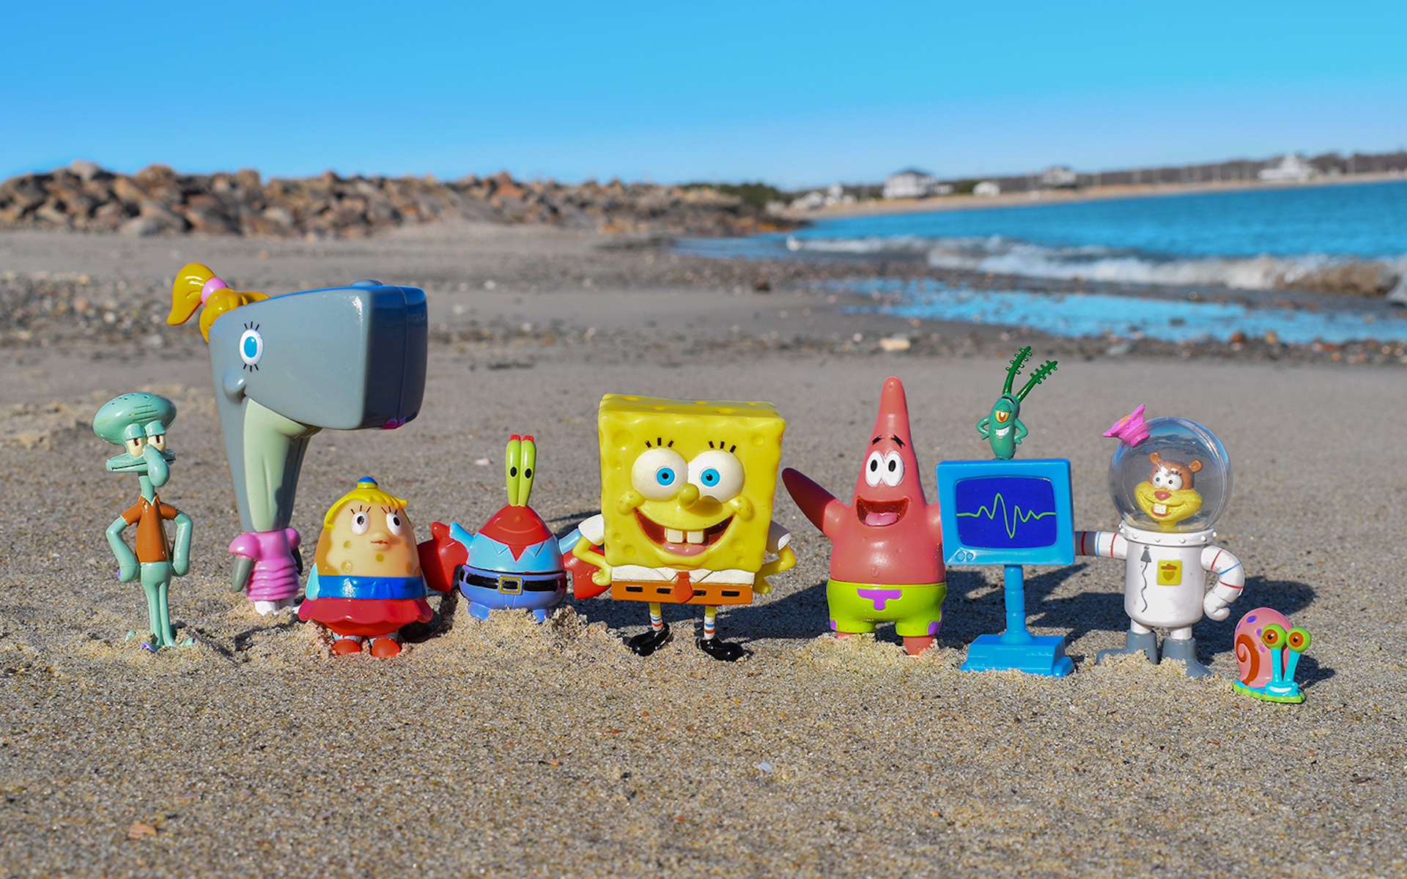
Let’s Practice with An Existing Fantasy Culture

Slide 26
1) What is the name and make-up of your group of people? Are they human? Non-human? Post pictures from your Jamboard session to help the rest of the class visualize what they look like.
2) Describe the location where your people live. Where is it located (next to a river? on top of a mountain? on the Moon?)? Why does your group live in this region?
3) Now focus on the government and economy of your people. Who is in charge of the group? How do they generate resources to survive?
4) Finally, think about specific individuals in your group. Choose three individuals. Describe their personalities, their professions, and how their relationship with the other two individuals you've chosen.

Slide 27

Let’s Practice with An Existing Fantasy Culture

Slide 28
1) What is the name and make-up of your group of people? Are they human? Non-human? Post pictures from your Whiteboard session to help the rest of the class visualize what they look like.
2) Describe the location where your people live. Where is it located (next to a river? on top of a mountain? on the Moon?)? Why does your group live in this region?
3) Now focus on the government and economy of your people. Who is in charge of the group? How do they generate resources to survive?
4) Finally, think about specific individuals in your group. Choose three individuals. Describe their personalities, their professions, and how their relationship with the other two individuals you've chosen.

Slide 29
Elijah's Culture
LIN 200 Honors (F24).whiteboard

Slide 30
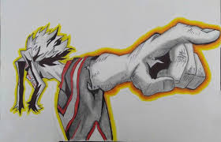
Now it's your turn!

Slide 31
What will you be doing?
Each student will be creating their own preliminary universes within a Whiteboard framework.
On Friday, you'll continue working on it, and share with your group members.
Next Wednesday, you will make a “pitch” for that universe in class.
We, as a class, will give you constructive feedback, which you'll use to build upon in your first component.
You have roughly two minutes to make your pitch.

Slide 32
1) What is the name and make-up of your group of people? Are they human? Non-human? Post pictures from your Whiteboard session to help the rest of the class visualize what they look like.
2) Describe the location where your people live. Where is it located (next to a river? on top of a mountain? on the Moon?)? Why does your group live in this region?
3) Now focus on the government and economy of your people. Who is in charge of the group? How do they generate resources to survive?
4) Finally, think about specific individuals in your group. Choose three individuals. Describe their personalities, their professions, and how their relationship with the other two individuals you've chosen.

Slide 33
Linguistics 200, Day 3
Devising your own culture

Slide 34
Last Time

Slide 35
1) What is the name and make-up of your group of people? Are they human? Non-human? Post pictures from your Jamboard session to help the rest of the class visualize what they look like.
2) Describe the location where your people live. Where is it located (next to a river? on top of a mountain? on the Moon?)? Why does your group live in this region?
3) Now focus on the government and economy of your people. Who is in charge of the group? How do they generate resources to survive?
4) Finally, think about specific individuals in your group. Choose three individuals. Describe their personalities, their professions, and how their relationship with the other two individuals you've chosen.

Slide 36
What will you be doing?
Each student will be creating their own preliminary universes within a Whiteboard framework.
Next Wednesday, you will make a “pitch” for that universe in class.
We, as a class, will give you constructive feedback, which you'll use to build upon in your first component.
You have roughly two minutes to make your pitch.

Slide 37
Today
Continue working on your universe
Discuss your universe with your groupmates at 10:35, offer feedback/help when needed!

Slide 38
Now it's your turn!

Slide 39
10:35 -- Be sure to discuss your work with your groupmates!
1) What is the name and make-up of your group of people? Are they human? Non-human? Post pictures from your Whiteboard session to help the rest of the class visualize what they look like.
2) Describe the location where your people live. Where is it located (next to a river? on top of a mountain? on the Moon?)? Why does your group live in this region?
3) Now focus on the government and economy of your people. Who is in charge of the group? How do they generate resources to survive?
4) Finally, think about specific individuals in your group. Choose three individuals. Describe their personalities, their professions, and how their relationship with the other two individuals you've chosen.

